Slide 1
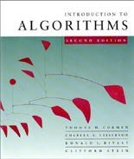
LECTURE 5
Sorting Lower Bounds
Decision trees
Linear-Time Sorting
Counting sort
Radix sort
Appendix: Punched cards
Dr. Yeshwant Singh

Slide 2
How fast can we sort?
All the sorting algorithms we have seen so far are comparison sorts: only use comparisons to determine the relative order of elements.
E.g., insertion sort, merge sort, quicksort, heapsort.
The best worst-case running time that we’ve seen for comparison sorting is O(n lg n) .
Is O(n lg n) the best we can do?
Decision trees can help us answer this question.

Slide 3











Decision-tree example
Sort ⟨a₁, a₂, …, a_{n}⟩
2:3
1:2
1:3
123
1:3
213
2:3
132
312
231
321
Each internal node is labeled i:j for i, j ∈ {1, 2,…, n}.
The left subtree shows subsequent comparisons if a_{i} ≤ a_{j}.
The right subtree shows subsequent comparisons if a_{i} > a_{j}.

Slide 4
Decision-tree example
Sort ⟨a₁, a₂, a₃⟩
= ⟨ 9, 4, 6 ⟩:
1:2
9 ≥ 4
1:3
2:3
123
1:3
213
2:3
132
312
231
321
Each internal node is labeled i:j for i, j ∈ {1, 2,…, n}.
The left subtree shows subsequent comparisons if a_{i} ≤ a_{j}.
The right subtree shows subsequent comparisons if a_{i} > a_{j}.

Slide 5
Decision-tree example
Sort ⟨a₁, a₂, a₃⟩
= ⟨ 9, 4, 6 ⟩:
1:2
2:3
1:3
9 ≥ 6
123
1:3
213
2:3
132
312
231
321
Each internal node is labeled i:j for i, j ∈ {1, 2,…, n}.
The left subtree shows subsequent comparisons if a_{i} ≤ a_{j}.
The right subtree shows subsequent comparisons if a_{i} > a_{j}.

Slide 6
Decision-tree example
Sort ⟨a₁, a₂, a₃⟩
= ⟨ 9, 4, 6 ⟩:
1:2
2:3
1:3
123
1:3
213
2:3
4 ≤ 6
132
312
231
321
Each internal node is labeled i:j for i, j ∈ {1, 2,…, n}.
The left subtree shows subsequent comparisons if a_{i} ≤ a_{j}.
The right subtree shows subsequent comparisons if a_{i} > a_{j}.

Slide 7
Decision-tree example
Sort ⟨a₁, a₂, a₃⟩
= ⟨ 9, 4, 6 ⟩:
1:2
2:3
1:3
123
1:3
213
2:3
132
312
231
321
4 ≤ 6 ≤ 9
Each leaf contains a permutation ⟨π(1), π(2),…, π(n)⟩ to indicate that the ordering a_{π(1)} ≤ a_{π(2)} ≤ ☹ ≤ a_{π(n)} has been established.

Slide 8
Decision-tree model
A decision tree can model the execution of any comparison sort:
One tree for each input size n.
View the algorithm as splitting whenever it compares two elements.
The tree contains the comparisons along all possible instruction traces.
The running time of the algorithm = the length of the path taken.
Worst-case running time = height of tree.

Slide 9
Lower bound for decision- tree sorting
Theorem. Any decision tree that can sort n
elements must have height Ω(n lg n) .
Proof. The tree must contain ≥ n! leaves, since there are n! possible permutations. A height-h binary tree has ≤ 2^{h} leaves. Thus, n! ≤ 2^{h} .
∴ h ≥ lg(n!)
≥ lg ((n/e)^{n})
= n lg n – n lg e
(lg is mono. increasing) (Stirling’s formula)
= Ω(n lg n) .

Slide 10
Lower bound for comparison sorting
Corollary. Heapsort and merge sort are asymptotically optimal comparison sorting algorithms.

Slide 11
Sorting in linear time
Counting sort: No comparisons between elements.
Input: A[1 . . n], where A[ j]∈{1, 2, …, k} .
Output: B[1 . . n], sorted.
Auxiliary storage: C[1 . . k] .

Slide 12
Counting sort
for i ← 1 to k
do C[i] ← 0
for j ← 1 to n
do C[A[ j]] ← C[A[ j]] + 1
for i ← 2 to k
do C[i] ← C[i] + C[i–1]
for j ← n downto 1
do B[C[A[ j]]] ← A[ j]
C[A[ j]] ← C[A[ j]] – 1
⊳ C[i] = |{key = i}|
⊳ C[i] = |{key ≤ i}|

Slide 13



Counting-sort example
1
2
3
4
5
1
2
3
4
A:
4
1
3
4
3
C:
B:

Slide 14
Loop 1
 | 1 | 2 | 3 | 4 | 5 |  | 1 | 2 | 3 | 4
A: | 4 | 1 | 3 | 4 | 3 | C: | 0 | 0 | 0 | 0
B:
for i ← 1 to k
do C[i] ← 0

Slide 15
Loop 2
 | 1 | 2 | 3 | 4 | 5 |  | 1 | 2 | 3 | 4
A: | 4 | 1 | 3 | 4 | 3 | C: | 0 | 0 | 0 | 1
B:
for j ← 1 to n
do C[A[ j]] ← C[A[ j]] + 1
⊳ C[i] = |{key = i}|

Slide 16
Loop 2
 | 1 | 2 | 3 | 4 | 5 |  | 1 | 2 | 3 | 4
A: | 4 | 1 | 3 | 4 | 3 | C: | 1 | 0 | 0 | 1
B:
for j ← 1 to n
do C[A[ j]] ← C[A[ j]] + 1
⊳ C[i] = |{key = i}|

Slide 17
Loop 2
 | 1 | 2 | 3 | 4 | 5 |  | 1 | 2 | 3 | 4
A: | 4 | 1 | 3 | 4 | 3 | C: | 1 | 0 | 1 | 1
B:
for j ← 1 to n
do C[A[ j]] ← C[A[ j]] + 1
⊳ C[i] = |{key = i}|

Slide 18
Loop 2
 | 1 | 2 | 3 | 4 | 5 |  | 1 | 2 | 3 | 4
A: | 4 | 1 | 3 | 4 | 3 | C: | 1 | 0 | 1 | 2
B:
for j ← 1 to n
do C[A[ j]] ← C[A[ j]] + 1
⊳ C[i] = |{key = i}|

Slide 19
Loop 2
 | 1 | 2 | 3 | 4 | 5 |  | 1 | 2 | 3 | 4
A: | 4 | 1 | 3 | 4 | 3 | C: | 1 | 0 | 2 | 2
B:
for j ← 1 to n
do C[A[ j]] ← C[A[ j]] + 1
⊳ C[i] = |{key = i}|

Slide 20
Loop 3
 | 1 | 2 | 3 | 4 | 5 |  | 1 | 2 | 3 | 4
A: | 4 | 1 | 3 | 4 | 3 | C: | 1 | 0 | 2 | 2
B: |  |  |  |  |  | C': | 1 | 1 | 2 | 2
for i ← 2 to k
do C[i] ← C[i] + C[i–1]
⊳ C[i] = |{key ≤ i}|

Slide 21
Loop 3
 | 1 | 2 | 3 | 4 | 5 |  | 1 | 2 | 3 | 4
A: | 4 | 1 | 3 | 4 | 3 | C: | 1 | 0 | 2 | 2
B: |  |  |  |  |  | C': | 1 | 1 | 3 | 2
for i ← 2 to k
do C[i] ← C[i] + C[i–1]
⊳ C[i] = |{key ≤ i}|

Slide 22
Loop 3
 | 1 | 2 | 3 | 4 | 5 |  | 1 | 2 | 3 | 4
A: | 4 | 1 | 3 | 4 | 3 | C: | 1 | 0 | 2 | 2
B: |  |  |  |  |  | C': | 1 | 1 | 3 | 5
for i ← 2 to k
do C[i] ← C[i] + C[i–1]
⊳ C[i] = |{key ≤ i}|

Slide 23
Loop 4
 | 1 | 2 | 3 | 4 | 5 |  | 1 | 2 | 3 | 4
A: | 4 | 1 | 3 | 4 | 3 | C: | 1 | 1 | 3 | 5
B: |  |  | 3 |  |  | C': | 1 | 1 | 2 | 5
for j ← n downto 1
do B[C[A[ j]]] ← A[ j]
C[A[ j]] ← C[A[ j]] – 1

Slide 24
Loop 4
 | 1 | 2 | 3 | 4 | 5 |  | 1 | 2 | 3 | 4
A: | 4 | 1 | 3 | 4 | 3 | C: | 1 | 1 | 2 | 5
B: |  |  | 3 |  | 4 | C': | 1 | 1 | 2 | 4
for j ← n downto 1
do B[C[A[ j]]] ← A[ j]
C[A[ j]] ← C[A[ j]] – 1

Slide 25
Loop 4
 | 1 | 2 | 3 | 4 | 5 |  | 1 | 2 | 3 | 4
A: | 4 | 1 | 3 | 4 | 3 | C: | 1 | 1 | 2 | 4
B: |  | 3 | 3 |  | 4 | C': | 1 | 1 | 1 | 4
for j ← n downto 1
do B[C[A[ j]]] ← A[ j]
C[A[ j]] ← C[A[ j]] – 1

Slide 26
Loop 4
 | 1 | 2 | 3 | 4 | 5 |  | 1 | 2 | 3 | 4
A: | 4 | 1 | 3 | 4 | 3 | C: | 1 | 1 | 1 | 4
B: | 1 | 3 | 3 |  | 4 | C': | 0 | 1 | 1 | 4
for j ← n downto 1
do B[C[A[ j]]] ← A[ j]
C[A[ j]] ← C[A[ j]] – 1

Slide 27
Loop 4
 | 1 | 2 | 3 | 4 | 5 |  | 1 | 2 | 3 | 4
A: | 4 | 1 | 3 | 4 | 3 | C: | 0 | 1 | 1 | 4
B: | 1 | 3 | 3 | 4 | 4 | C': | 0 | 1 | 1 | 3
for j ← n downto 1
do B[C[A[ j]]] ← A[ j]
C[A[ j]] ← C[A[ j]] – 1

Slide 28
Analysis
for i ← 1 to k
Θ(k)
Θ(n)
do C[i] ← 0
for j ← 1 to n
do C[A[ j]] ← C[A[ j]] + 1
for i ← 2 to k
do C[i] ← C[i] + C[i–1]
for j ← n downto 1
do B[C[A[ j]]] ← A[ j]
C[A[ j]] ← C[A[ j]] – 1
Θ(k)
Θ(n)
Θ(n + k)

Slide 29
Running time
If k = O(n), then counting sort takes Θ(n) time.
But, sorting takes Ω(n lg n) time!
Where’s the fallacy?
Answer:
Comparison sorting takes Ω(n lg n) time.
Counting sort is not a comparison sort.
In fact, not a single comparison between elements occurs!

Slide 30
Stable sorting
Counting sort is a stable sort: it preserves the input order among equal elements.
A:
4
1
3
4
3
B:
1
3
3
4
4
Exercise: What other sorts have this property?

Slide 31

Radix sort
Origin: Herman Hollerith’s card-sorting machine for the 1890 U.S. Census. (See Appendix .)
Digit-by-digit sort.
Hollerith’s original (bad) idea: sort on most-significant digit first.
Good idea: Sort on least-significant digit first with auxiliary stable sort.

Slide 32
Operation of radix sort
3 2 9 | 7 2 0 | 7 2 0 | 3 2 9
4 5 7 | 3 5 5 | 3 2 9 | 3 5 5
6 5 7 | 4 3 6 | 4 3 6 | 4 3 6
8 3 9 | 4 5 7 | 8 3 9 | 4 5 7
4 3 6 | 6 5 7 | 3 5 5 | 6 5 7
7 2 0 | 3 2 9 | 4 5 7 | 7 2 0
3 5 5 | 8 3 9 | 6 5 7 | 8 3 9

Slide 33
Correctness of radix sort
Induction on digit position
Assume that the numbers are sorted by their low-order t – 1 digits.
Sort on digit t
7 2 0 | 3 2 9
3 2 9 | 3 5 5
4 3 6 | 4 3 6
8 3 9 | 4 5 7
3 5 5 | 6 5 7
4 5 7 | 7 2 0
6 5 7 | 8 3 9

Slide 34
Correctness of radix sort
Induction on digit position
Assume that the numbers are sorted by their low-order t – 1 digits.
Sort on digit t
Two numbers that differ in digit t are correctly sorted.
7 2 0 | 3 2 9
3 2 9 | 3 5 5
4 3 6 | 4 3 6
8 3 9 | 4 5 7
3 5 5 | 6 5 7
4 5 7 | 7 2 0
6 5 7 | 8 3 9

Slide 35
Correctness of radix sort
Induction on digit position
Assume that the numbers are sorted by their low-order
7 2 0 | 3 2 9
3 2 9 | 3 5 5
4 3 6 | 4 3 6
8 3 9 | 4 5 7
3 5 5 | 6 5 7
4 5 7 | 7 2 0
6 5 7 | 8 3 9
t – 1 digits.
Sort on digit t
Two numbers that differ in digit t are correctly sorted.
Two numbers equal in digit t are put in the same order as the input ⇒ correct order.

Slide 36
Analysis of radix sort
Assume counting sort is the auxiliary stable sort.
Sort n computer words of b bits each.
Each word can be viewed as having b/r base-2^{r}
digits.
Example: 32-bit word
8 8 8 8
r = 8 ⇒ b/r = 4 passes of counting sort on base-2⁸ digits; or r = 16 ⇒ b/r = 2 passes of counting sort on base-2¹⁶ digits.
How many passes should we make?

Slide 37
Analysis (continued)
Recall: Counting sort takes Θ(n + k) time to sort n numbers in the range from 0 to k – 1.
If each b-bit word is broken into r-bit pieces, each pass of counting sort takes Θ(n + 2^{r}) time. Since there are b/r passes, we have
⎛ b
(n + 2 )
r ⎞
T (n, b) = Θ
⎜
⎟
⎝ r ⎠
.
Choose r to minimize T(n, b):
Increasing r means fewer passes, but as
r >> lg n, the time grows exponentially.

Slide 38
Choosing r
T (n, b) = Θ⎛⎜ ^{b} (n + 2^{r} )⎞⎟
⎝ r ⎠
Minimize T(n, b) by differentiating and setting to 0.
Or, just observe that we don’t want 2^{r} >> n, and there’s no harm asymptotically in choosing r as large as possible subject to this constraint.
Choosing r = lg n implies T(n, b) = Θ(bn/lg n) .
For numbers in the range from 0 to n^{d} – 1, we have b = d lg n ⇒ radix sort runs in Θ(d n) time.

Slide 39
Conclusions
In practice, radix sort is fast for large inputs, as well as simple to code and maintain.
Example (32-bit numbers):
At most 3 passes when sorting ≥ 2000 numbers.
Merge sort and quicksort do at least ⎡lg 2000⎤ = 11 passes.
Downside: Unlike quicksort, radix sort displays little locality of reference, and thus a well-tuned quicksort fares better on modern processors, which feature steep memory hierarchies.

Slide 40
Appendix: Punched-card technology
Herman Hollerith (1860-1929)
Punched cards
Hollerith’s tabulating system
Operation of the sorter
Origin of radix sort
“Modern” IBM card
Web resources on punched-card _{Return to last}
technology
slide viewed.

Slide 41
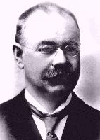
Herman Hollerith (1860-1929)
The 1880 U.S. Census took almost 10 years to process.
While a lecturer at MIT, Hollerith prototyped punched-card technology.
His machines, including a “card sorter,” allowed the 1890 census total to be reported in 6 weeks.
He founded the Tabulating Machine Company in 1911, which merged with other companies in 1924 to form International Business Machines.

Slide 42
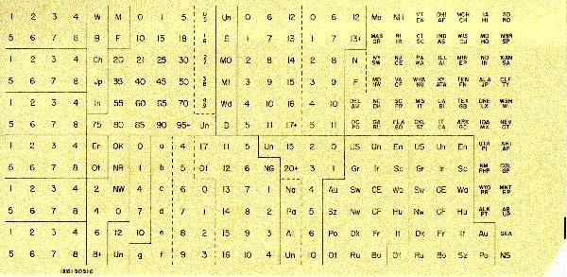
Punched cards
Punched card = data record.
Hole = value.
Algorithm = machine + human operator.
Replica of punch card from the 1900 U.S. census. [Howells 2000]

Slide 43
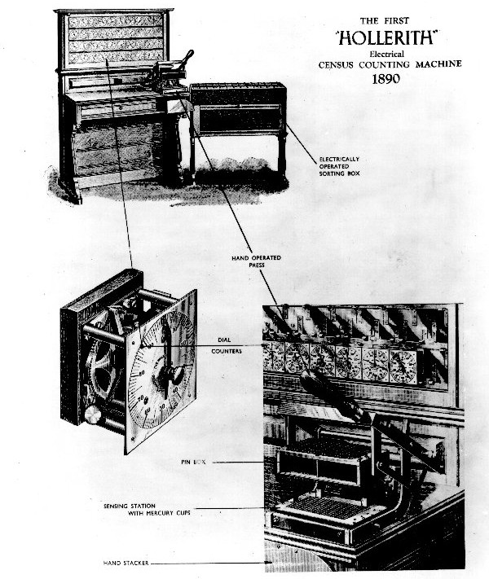
Hollerith’s tabulating system
Figure from [Howells 2000].
Pantograph card punch
Hand-press reader
Dial counters
Sorting box

Slide 44
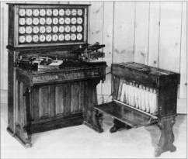







Operation of the sorter
An operator inserts a card into the press.
Pins on the press reach through the punched holes to make electrical contact with mercury- filled cups beneath the card.
Whenever a particular digit value is punched, the lid of the corresponding sorting bin lifts.
The operator deposits the card into the bin and closes the lid.
Hollerith Tabulator, Pantograph, Press, and Sorter
When all cards have been processed, the front panel is opened, and the cards are collected in order, yielding one pass of a stable sort.

Slide 45
Origin of radix sort
Hollerith’s original 1889 patent alludes to a most- significant-digit-first radix sort:
“The most complicated combinations can readily be counted with comparatively few counters or relays by first assorting the cards according to the first items entering into the combinations, then reassorting each group according to the second item entering into the combination, and so on, and finally counting on a few counters the last item of the combination for each group of cards.”
Least-significant-digit-first radix sort seems to be a folk invention originated by machine operators.

Slide 46
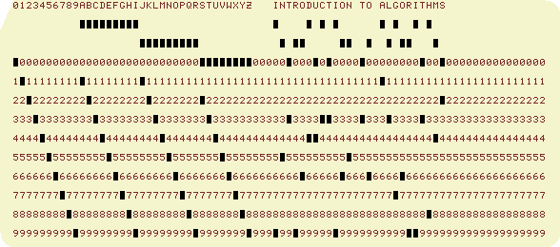
“Modern” IBM card
One character per column.
Produced by the WWW Virtual Punch- Card Server.
So, that’s why text windows have 80 columns!

Slide 47
Web resources on punched- card technology
Doug Jones’s punched card index
Biography of Herman Hollerith
The 1890 U.S. Census
Early history of IBM
Pictures of Hollerith’s inventions
Hollerith’s patent application (borrowed from Gordon Bell’s CyberMuseum)
Impact of punched cards on U.S. history

